Slide 1


MATH 5473 Project 2
SHENG Rui, LI Haobo, TENG Fei, CHEN Zixin
17/05 2023

Slide 2
Motivation
Fact: Noticeable shift in research focus over the past few decades.
Researchers should keep up with current trends of research topics.
Difficulty: The sheer volume of research papers across various areas makes it impractical to analyze the progression of topic shift.

Slide 3
Dataset and Methods
5811 NIPS papers
1987-2015
counts the word appearances with 11463 words in total
Feature Extraction
Dimension Reduction
Topic Extraction
Dataset
Methods

Slide 4
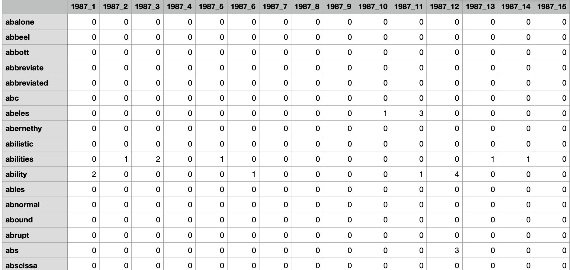
Feature Extraction
Different research topics have different focusing words.
Use word frequencies to describe each topic.
Each column represents an accepted paper in NIPS.

Slide 5
Dimensionality Reduction
Sparsity: The word frequency matrix contains plenty of 0 frequency entries.
Hard to use in downstream tasks
Project original feature space into a denser space
Applying dimensionality reduction algorithms
Applying visualization techniques to display transformed features in 2D/3D space.

Slide 6
Topic Extraction
Problem: There are no keyword labels in the NIPS dataset.
Unsupervised cluster algorithms to classify papers.
Algorithm: K-Means.
Paper instances in the NIPS dataset all belong to the machine learning area.
All instances are accepted papers, and few outliers exist.
Summarize the top-k frequent words for each paper cluster.

Slide 7
Dimensionality reduction algorithms
Principal Component Analysis (PCA)
t-distributed Stochastic Neighbor Embedding (t-SNE)
Gaussian Random Projection
Kernel PCA
Fast Independent Component Analysis (Fast ICA)
Sparse PCA
Non-negative Matrix Factorization (NMF)
Uniform Manifold Approximation and Projection (UMAP)

Slide 8
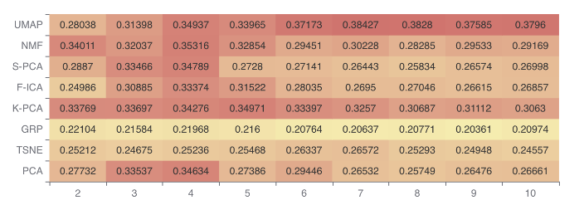
Experiments
The effectiveness of dimensionality reduction algorithms.
Metric: Silhouette coefficients
Evaluation: The similarity between clusters.
We select UMAP and k=7 in the following experiments

Slide 9
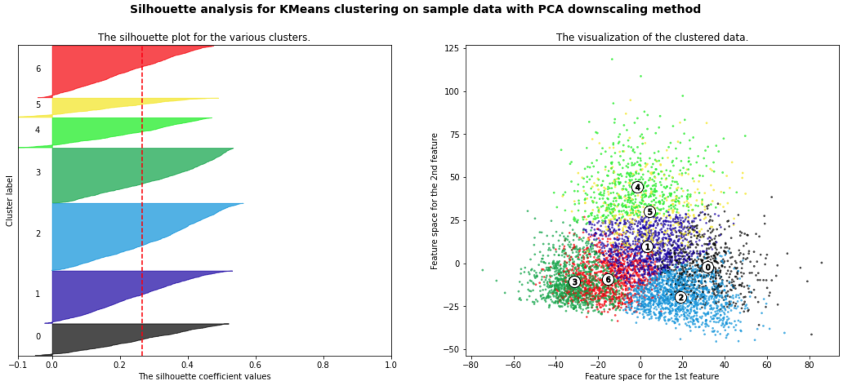
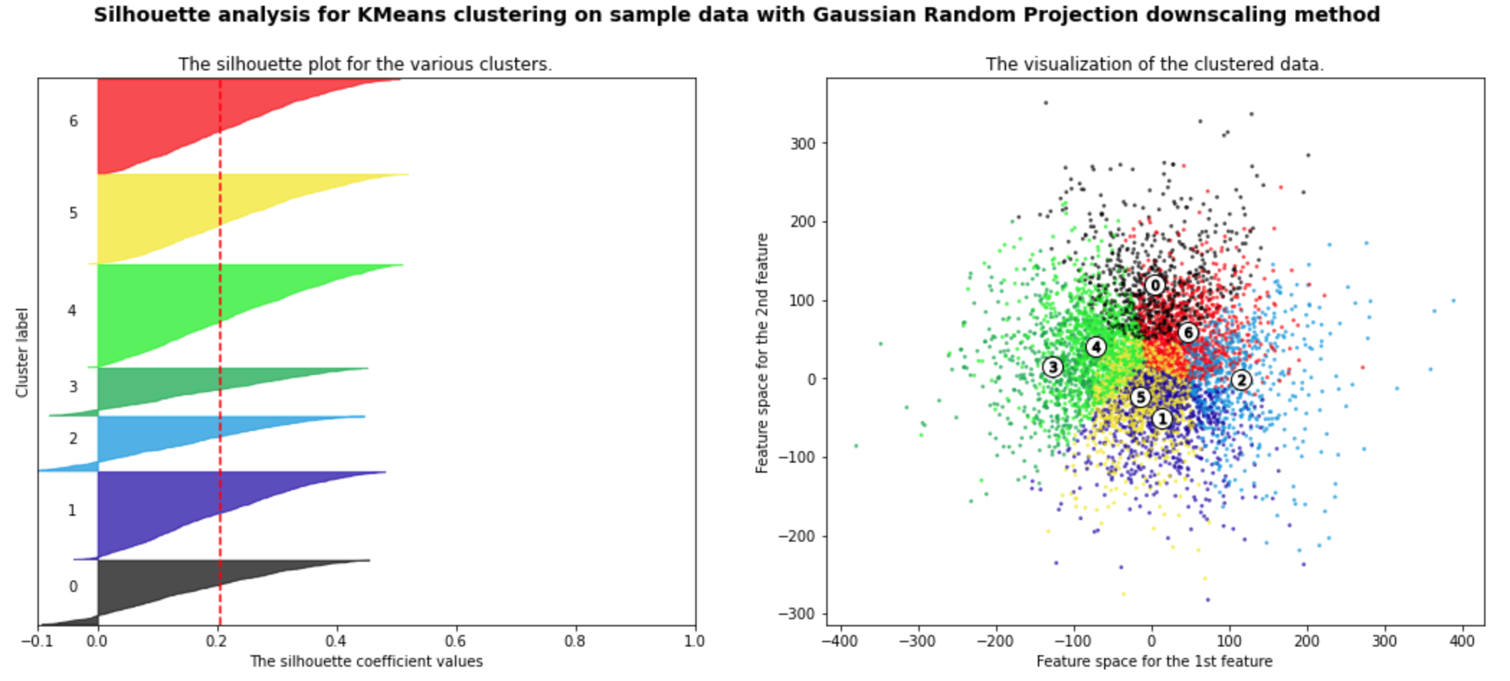
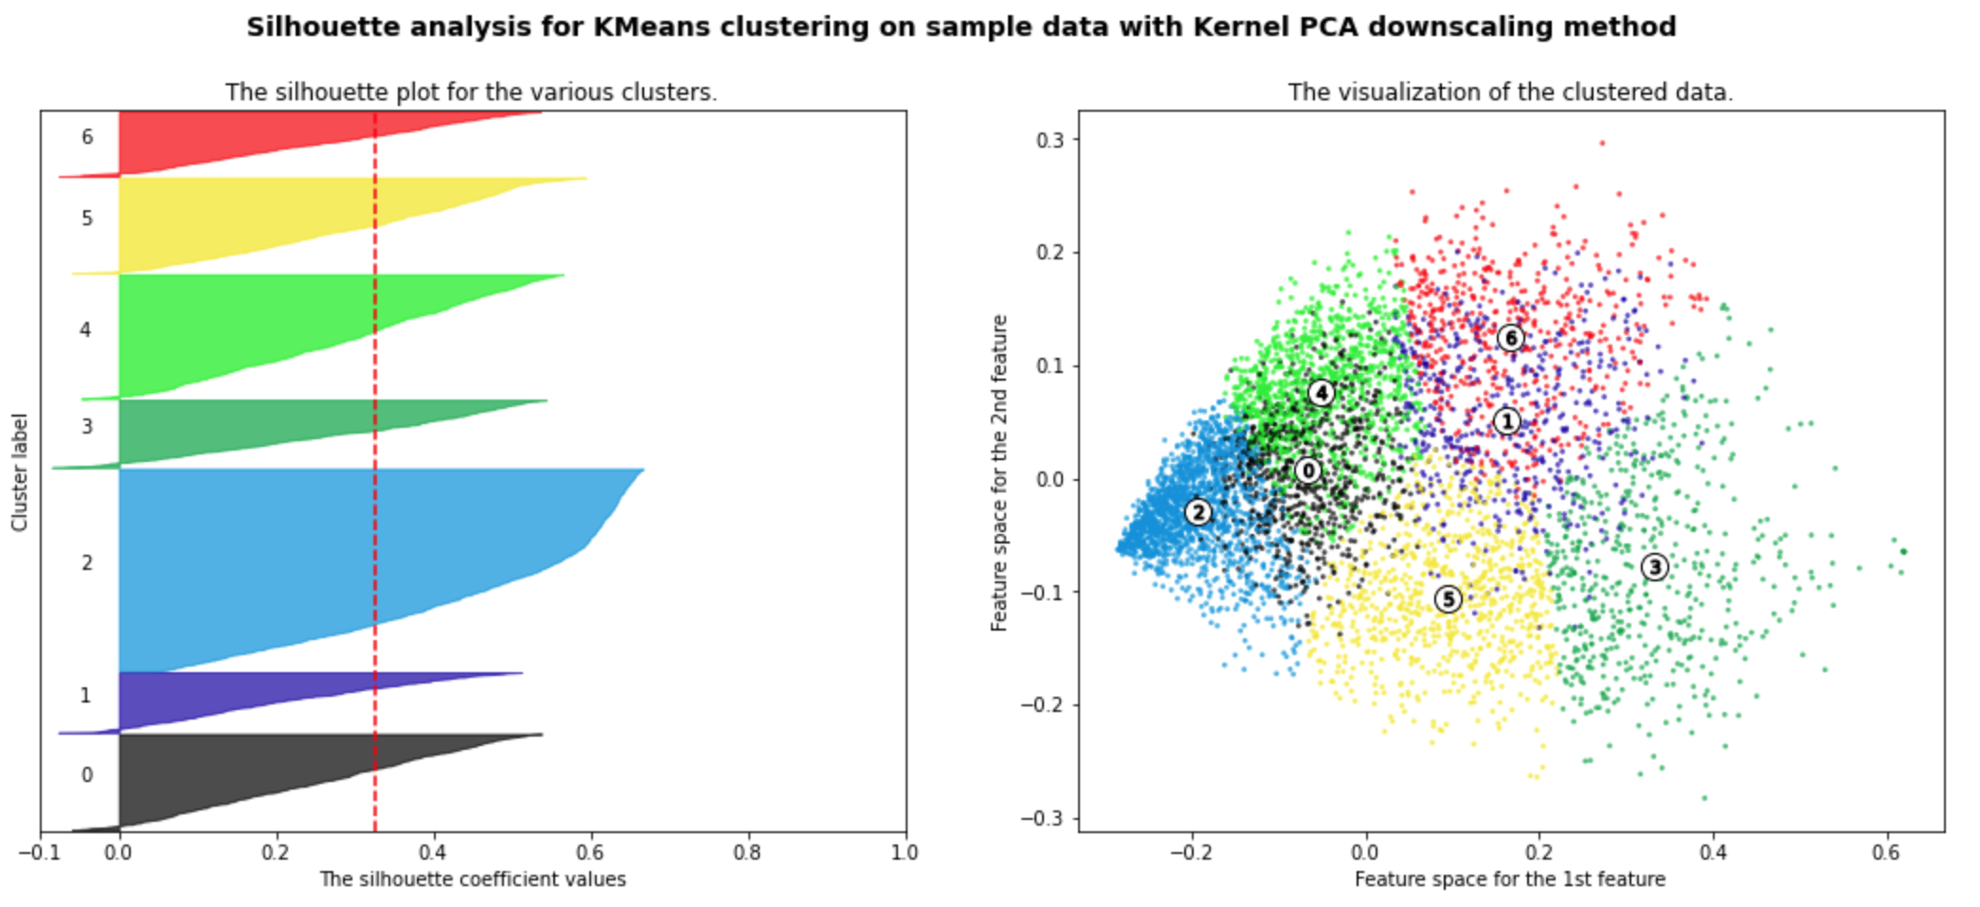
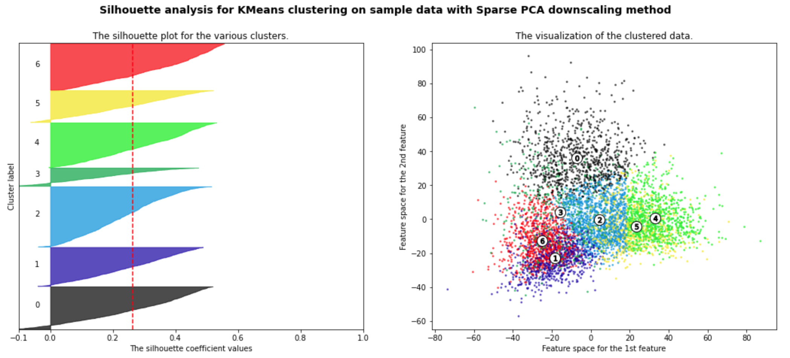
Experiments (cont’d)
Silhouette analysis for each dimensionality reduction algorithms.

Slide 10
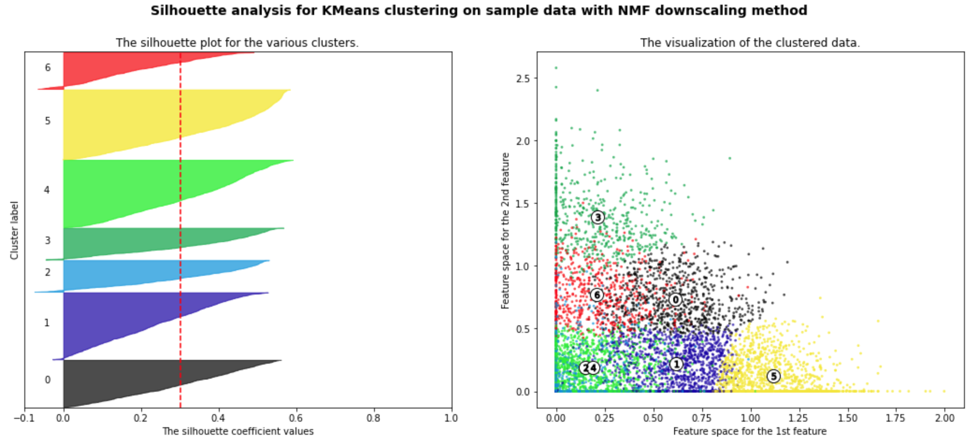
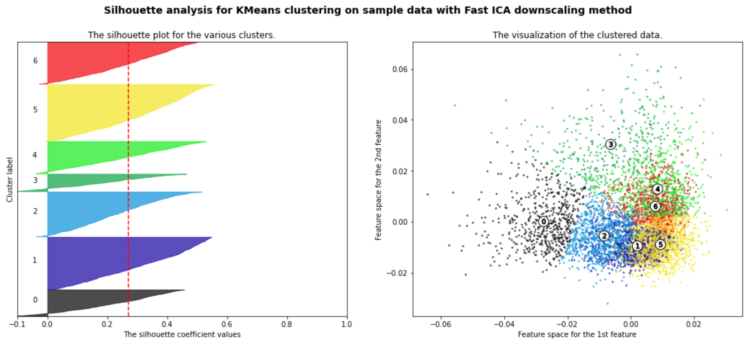
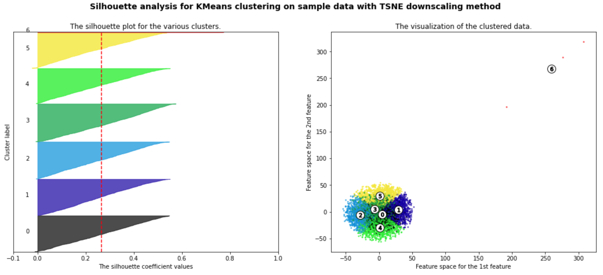
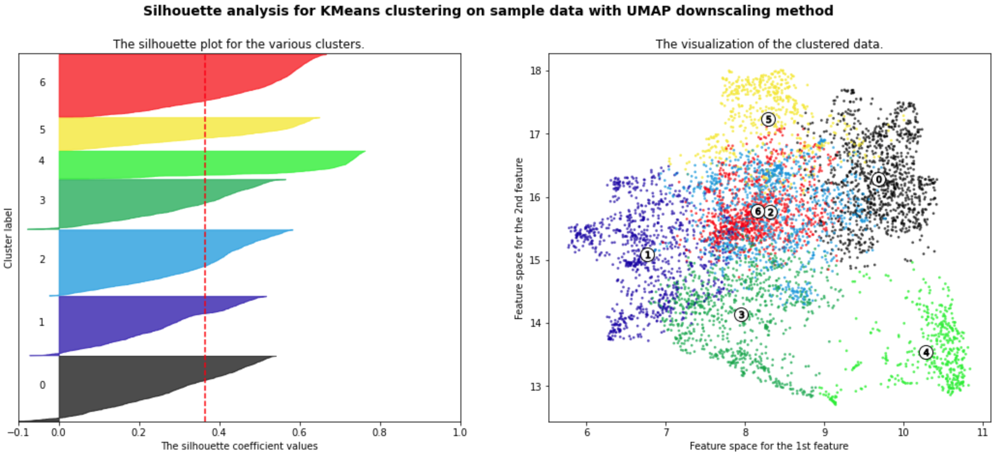
Experiments (cont’d)
Silhouette analysis for each dimensionality reduction algorithms.

Slide 11
Research topics

Slide 12
Research topics
Infer the topic from the frequent words
Neural network
Matrix algorithm
Statistical machine learning
Machine learning theory
Reinforce learning
Computer vision
Neural Model
Cluster 0
Cluster 1
Cluster 2
Cluster 3
Cluster 4
Cluster 5
Cluster 6
Notes:
Cluster 0: Neural network
Cluster 1: Matrix algorithm
Cluster 2: Statistical machine learning
Cluster 3: Machine learning theory
Cluster 4: Reinforce learning
Cluster 5: Computer vision
Cluster 6: Neural Mode

Slide 13
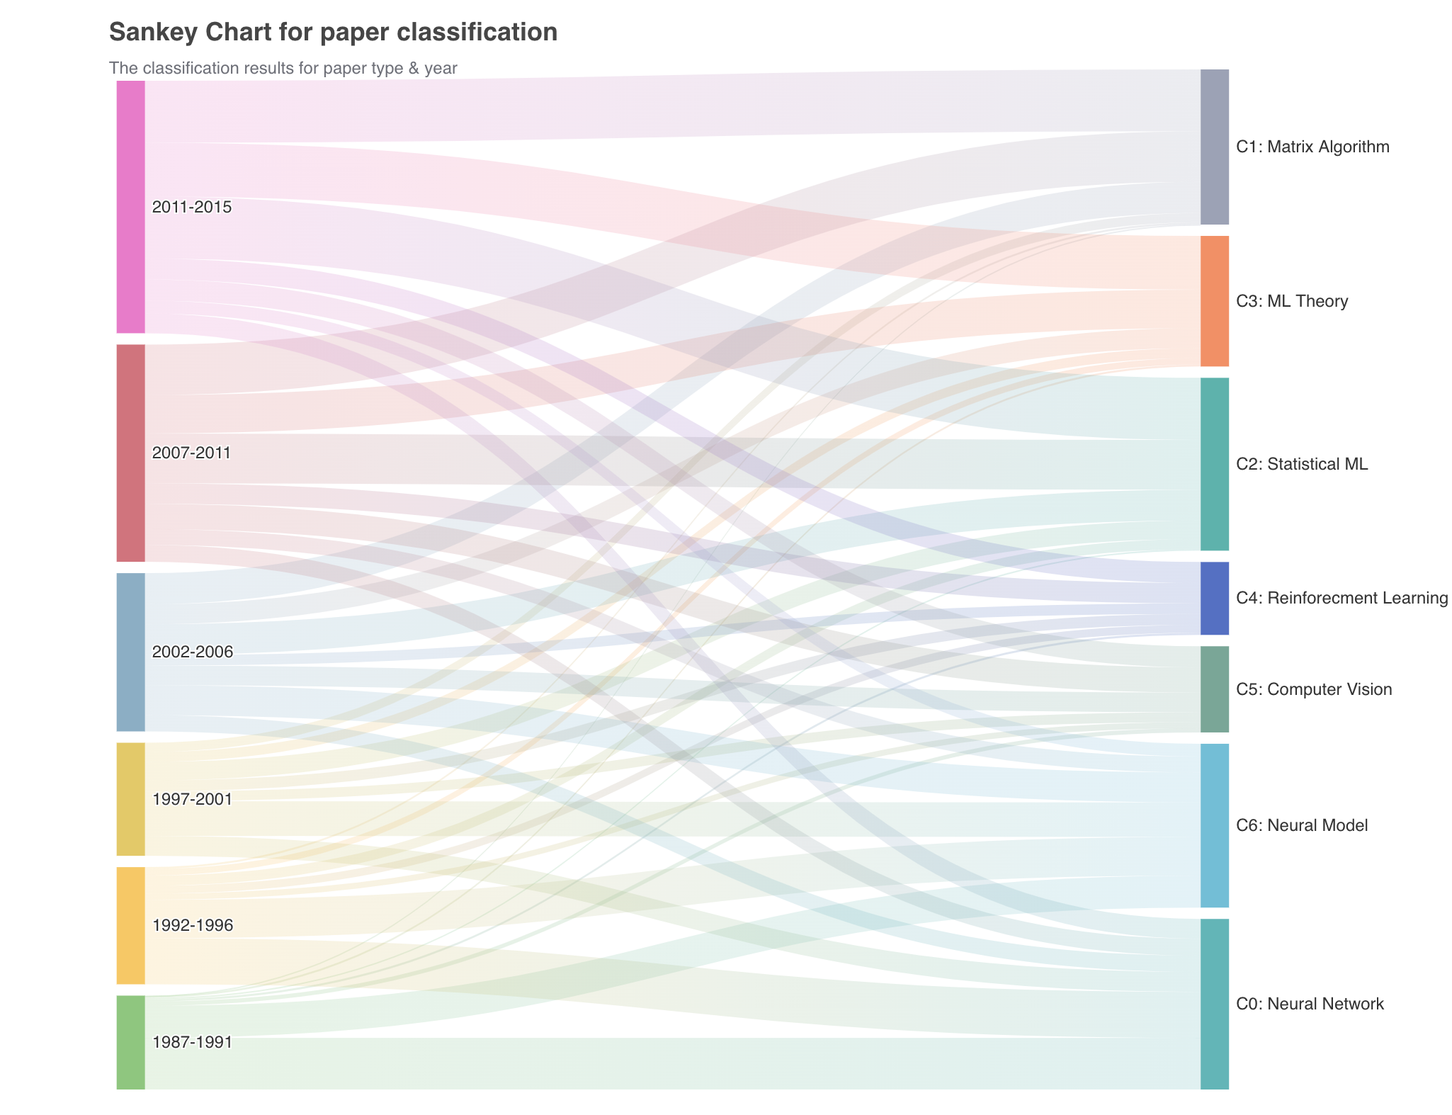

The trend for research topics
Visualization:
Sanky chart: flow diagram to depict the flow of data of information between nodes.
Trend:
‘Neural network’ (0)
‘Neural model’(6)
‘Matrix algorithm’ (1)
‘Statistical machine learning’ (2)
‘Machine learning theory’ (3)
Notes:
Trend:
The number of papers related to ‘Neural network’ and ‘Neural model’(0 & 6) has gradually decreased.
The number of papers related to ‘Matrix algorithm’, ‘Statistical machine learning’, ‘Machine learning theory’(1, 2 & 3) has gradually increased.

Slide 14
Discussion
Strength
A comprehensive comparison of various methods.
A visual analytics system providing an intuitive understanding of trends.
Interactive visualization: explore and delve deeper into the patterns.
Weakness
We did not extensively discuss the dimensionality reduction techniques.
we did not extensively validate alternative clustering techniques.
Future work
Methods that take into account the semantic relationships between words.
Explore the effectiveness of the approach on larger datasets.
Investigate its potential applications in other domains.

Slide 15

THANKS!

